Slide 1
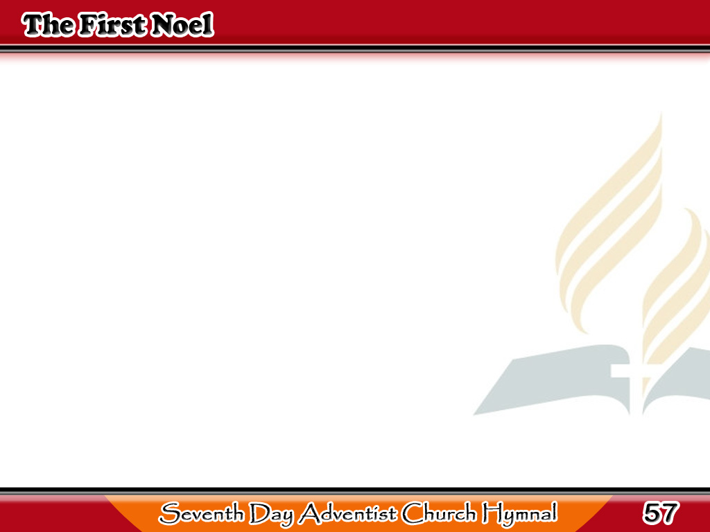
Ang Unang Noel
The first noel the angel did say
Was to certain poor
shepherds in fields as they lay;
In fields where they lay
keeping their sheep,
1/5

Slide 2
Ang Unang Noel
-Refrain-
On a cold winter’s night
that was so deep.
Noel, Noel, Noel, Noel,
Born is the King of Israel.
1/5

Slide 3
Ang Unang Noel
They looked up and saw a star
Shining in the east,
beyond them far,
And to the earth
it gave great light,
2/5

Slide 4
Ang Unang Noel
-Refrain-
And so it continued
both day and night.
Noel, Noel, Noel, Noel,
Born is the King of Israel.
2/5

Slide 5
Ang Unang Noel
And by the light of that same star,
Three wise men
came from country far;
To seek for a king
was their intent,
3/5

Slide 6
Ang Unang Noel
-Refrain-
And to follow the star
wherever it went.
Noel, Noel, Noel, Noel,
Born is the King of Israel.
3/5

Slide 7
Ang Unang Noel
This star drew nigh
to the northwest,
O’er Bethlehem it took its rest,
And there it did
both stop and stay,
4/5

Slide 8
Ang Unang Noel
-Refrain-
Right over the place
where Jesus lay.
Noel, Noel, Noel, Noel,
Born is the King of Israel.
4/5

Slide 9
Ang Unang Noel
Then entered in those
wise men three,
Full reverently upon the knee,
And offered there,
in His presence,
5/5

Slide 10
Ang Unang Noel
-Refrain-
Their gold, and myrrh,
and frank incense.
Noel, Noel, Noel, Noel,
Born is the King of Israel.
5/5

